Slide 1

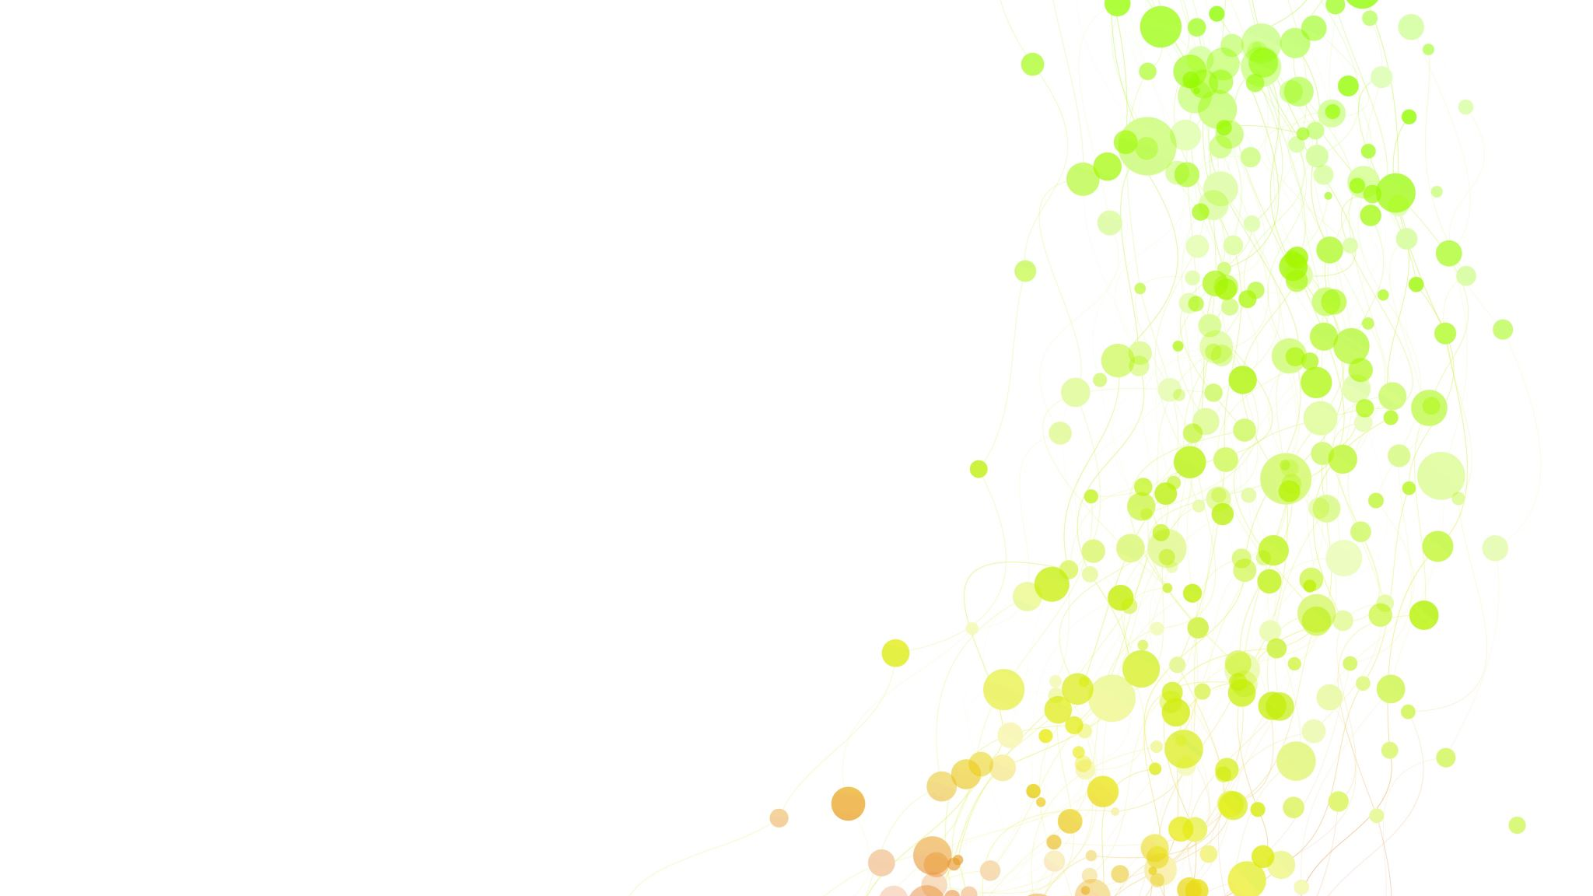
Mushroom Classification
Prerana Giri
5th B

Slide 2
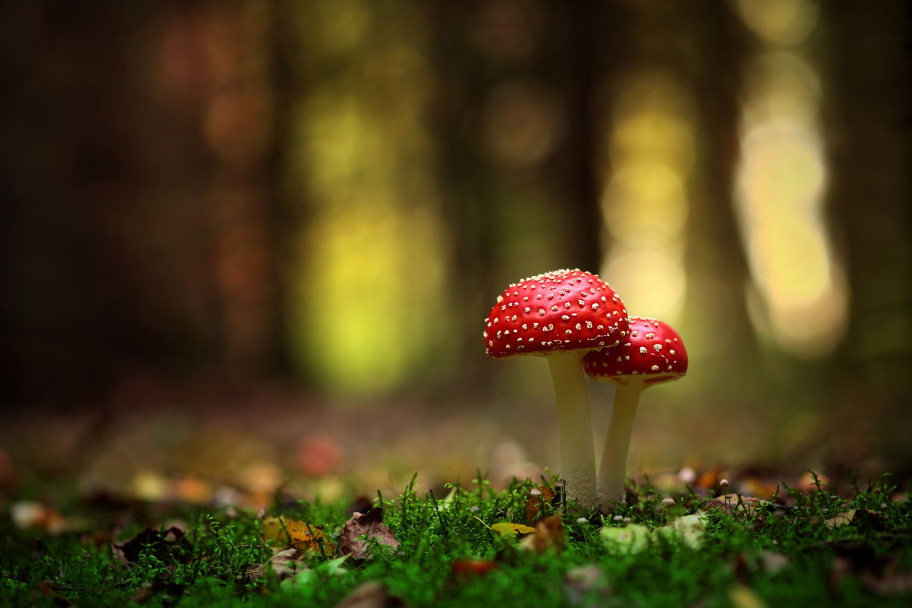
Introduction
Mushroom classification is a beginner machine learning problem.
The objective is to correctly classify if the mushroom is edible or poisonous by it's specifications like cap shape, cap color, gill color, etc. using different classifiers.

Slide 3
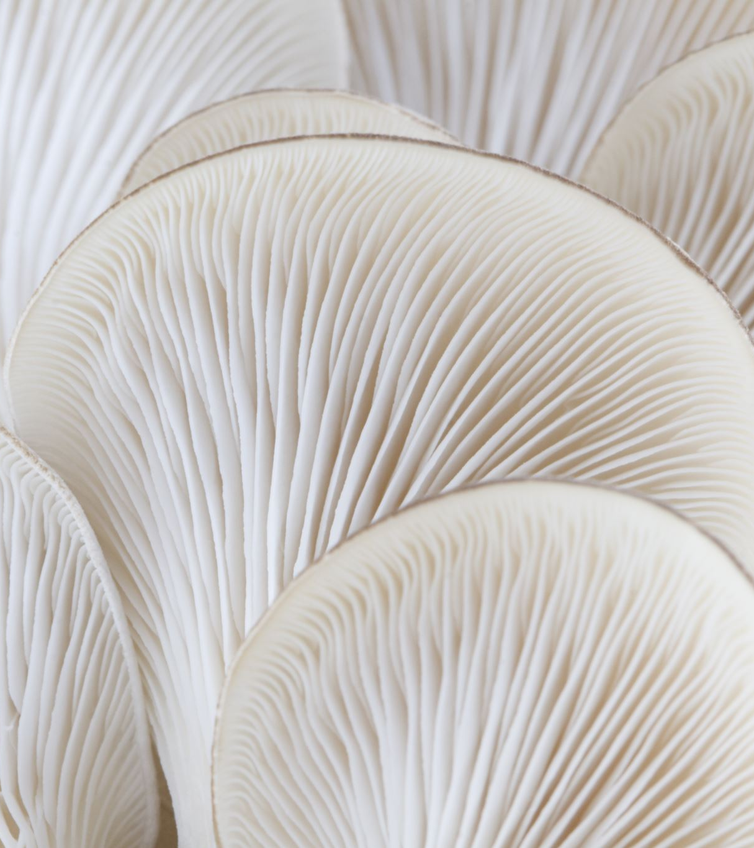
Objectives of mushroom classification
The purpose of this report is to process a dataset using Python programming language.
This dataset used in this project contains 8124 instances of mushrooms with 23 features like cap-shape, cap-surface, cap-color, bruises, odor, etc.
The aim to identify mushroom and classify it into two categories (poisonous and nonpoisonous) using machine learning techniques.

Slide 4


Steps
Import Libraries
Read data
Define Target(y) and features(x)
Train, test and split
Identify the types of problem and select the model
Train the model
Predict the model
Find the accuracy of the model

Slide 5
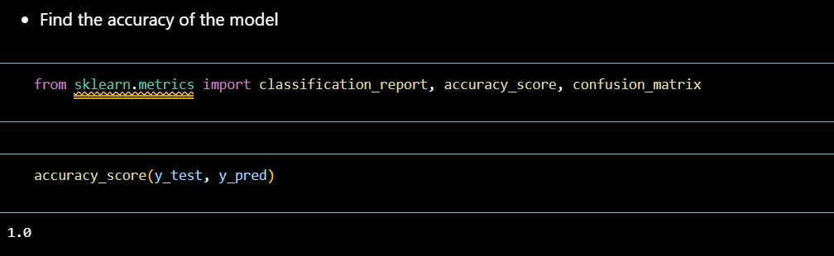
Accuracy of mushroom
Here the accuracy score is 1.0, it means that the model is 100% accurate.

Slide 6

Logistic Regression for Classification
Simple: It is relatively easy to understand and interpret.
Scalability: It can be applied to both small and large datasets without requiring extensive computational resources.
Well-Studied and Understood: It has been extensively studied and has a well-understood mathematical foundation.
Widely Used: It is used in a wide range of fields, including healthcare, finance, marketing, etc.

Slide 7
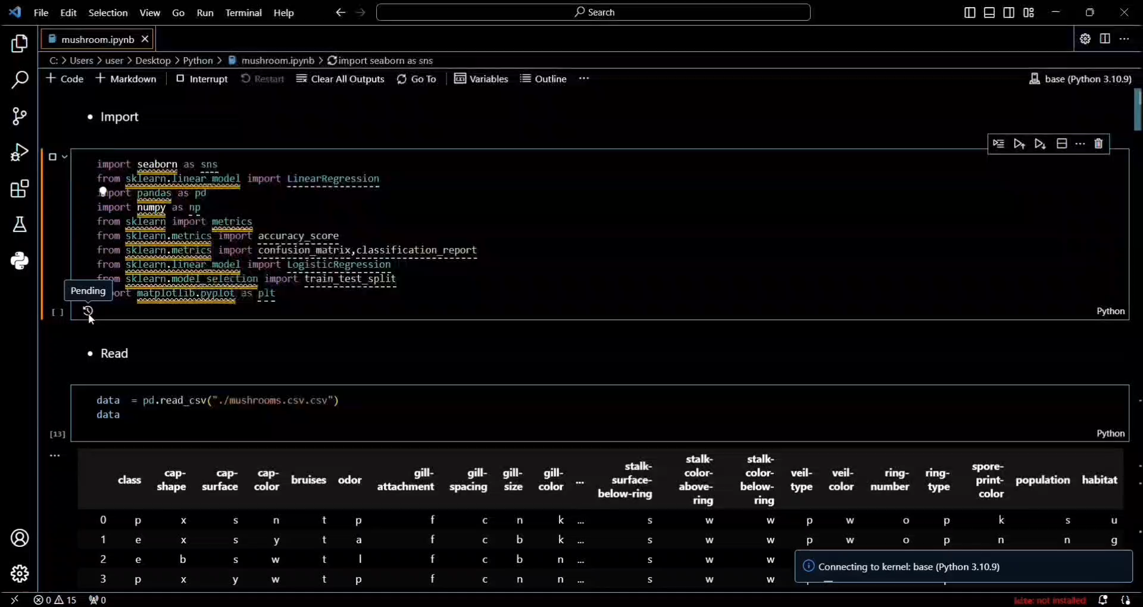
Demo

Slide 8
Conclusion
In conclusion, with confusion matrix we saw that our train and test datas balanced, so there is no problem in there. Most of classfication methods hit 100% accuracy with this dataset.

Slide 9



Thank you

